Slide 1
A Natural Language Processing System for Truth Detection and Text Summarization
INDIVIDUAL TASK 2
GROUP 40
Submitted By:
Md Shakibul Alam
ID: 20301286 Section: 1 Submitted to:
Annajiat Alim Rasel
RA:
Farah & Sabbir

Slide 2
OUTLINE
INTRODUCTION
MOTIVATION
CONTRIBUTION
METHODOLOGIES AND EXPERIMENTS
RESULT
LIMITATIONS
FUTURE WORK
CONCLUSION

Slide 3
INTRODUCTION
The rise of fake news on social media has alarming societal consequences, influencing public opinion and jeopardizing global well-being.
Text preprocessing techniques, including natural language processing methods, are employed to enhance the accuracy of fake news detection by removing stop words and applying stemming.
Long Short-Term Memory (LSTM) networks, a subset of recurrent neural networks, play a crucial role in summarizing and detecting patterns in textual information, contributing to effective identification of deceptive content.
Ongoing research efforts are crucial to address the challenges posed by the dynamic nature of fake news, with a focus on advanced machine learning models, interdisciplinary collaborations, and ethical considerations for robust solutions.

Slide 4
motivation
This paper delves into the pervasive problem of fake news, proposing a truth detection system designed to identify false information and summarize text.
Through a comparative analysis of various artificial intelligence models, the document evaluates their accuracy rates in both fake news detection and text summarization.
The exploration encompasses multiple techniques such as social network-based, knowledge-based, style-based, and stance-based content analysis, all aimed at effectively identifying instances of fake news.
The paper reviews existing literature and addresses challenges associated with automated fake news detection, providing implementation details for models like logistic regression, naive Bayes, decision tree, random forest, boosting ensemble classifiers, and LSTM, ultimately presenting an innovative AI-based approach to combat false news and enhance text summarization.

Slide 5
contribution
This paper introduces a groundbreaking truth detection system, merging AI models for fake news detection and text summarization.
Comparative analysis highlights LSTM's remarkable accuracy, reaching 99% on a smaller dataset and 98.6% on a larger one.
The study explores various fake news identification techniques, including user-based, social network-based, visual-based, and style-based content analysis.
The paper also delves into existing literature and challenges related to automated fake news detection.

Slide 6
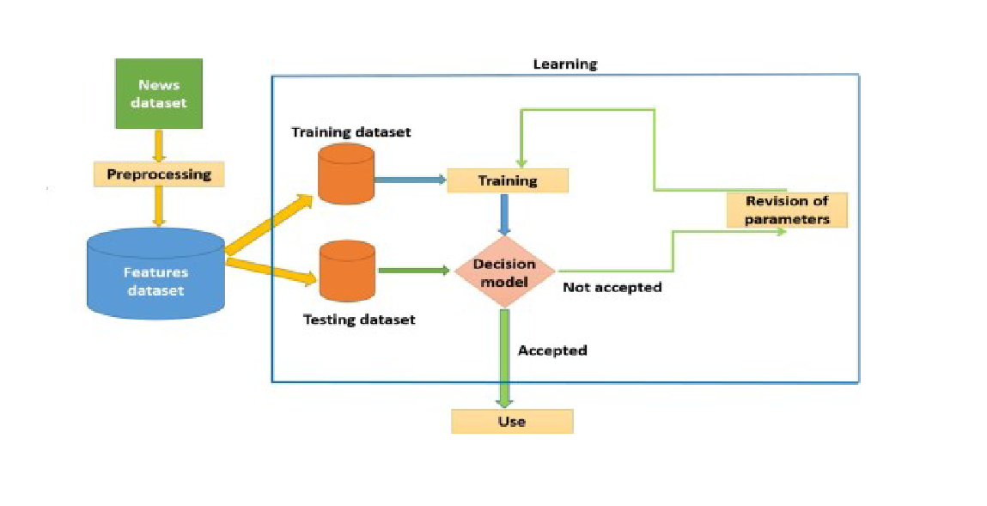
Methodology
The proposed system processes gathered data with metadata, undergoing pre-processing steps that include HTML content removal, punctuation elimination, stop-word removal, and lemmatization.
The cleaned data is then divided into training and testing sets to facilitate the development and evaluation of the system.
The training module utilizes a support vector machine for decision modeling, involving processes like train-test splitting and tokenization.
Various models, including Logistic Regression, Naive Bayes, Decision Tree, Random Forest, Boosting Ensemble Classifiers, and LSTM, are employed and evaluated to optimize accuracy.
Parameter tuning is implemented to enhance the selected algorithm's accuracy, and the overall approach aims to optimize data efficiency and improve model performance through systematic preprocessing and diverse model evaluations.

Slide 7
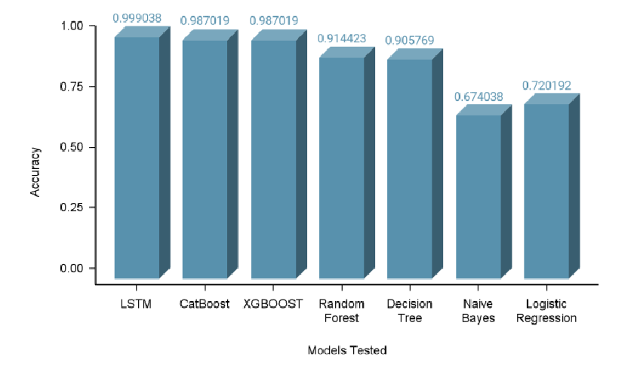
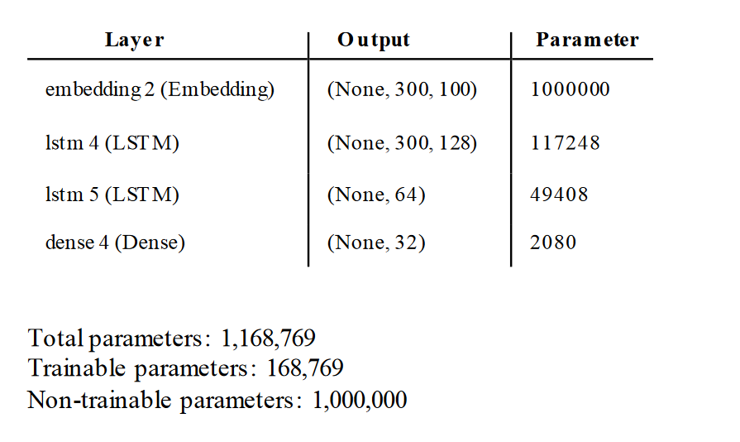
results
The LSTM cells exhibited superior performance, surpassing all other models with an accuracy of 99% for the smaller dataset and 98.6% for the larger dataset in fake news detection and text summarization.
The document compares models, including logistic regression, naive Bayes, decision tree, random forest, boosting ensemble classifiers, and LSTM, highlighting their accuracy rates.
Notably, the Naive Bayes model recorded the lowest accuracy at 67.4%, while the LSTM model achieved the highest accuracy at 99.9% in the smaller dataset.
The document outlines various fake news identification techniques, encompassing user-based content, social network-based content, visual-based content, and style-based content, among others.
Overall, the results emphasize the strong performance of the LSTM model in detecting fake news and summarizing text based on the conducted comparisons and accuracy rates.

Slide 8
Limitation
Assumes users will only use the subject field, limiting the system's applicability beyond specific domains.
Fails to discuss key metrics like precision and recall, hindering a comprehensive assessment of system reliability.

Slide 9
Future works
The paper suggests future work in advancing natural language processing and AI to address misinformation challenges across diverse sectors such as healthcare and finance.
Future prospects include the application of the truth detection system in various domains, with potential uses in social media for content flagging, pre-publishing verification in news agencies, and real-time source credibility integration into web browsers.
The mention of AI in text summarization hints at broader applications in journalism and research, indicating potential for increased productivity in these fields.
The paper advocates for continued research to refine truth detection systems, emphasizing the importance of fostering trustworthy information ecosystems for broader societal benefits.

Slide 10
conclusion
Neural networks, especially LSTM, excel in truth detection, achieving 98.6% accuracy through modifications and parameter adjustments. Subject-specificity requires separate models, while text summarization suggests room for improvement.

Slide 11
Thanks for watching

